Slide 1
POLITICAL JUGGERNAUTS A Quantative Analysis of Canditates in the 2019 Lok Sabha Elections
GOVERNMENT ARTS COLLEGE AUTONOMOUS KARUR

Slide 2
TEAM MEMBERS
S.Nivetha Team Leader
M.Mawliswaran Team Member
V.S.Mourya Team Member
K.Nagavel Team Member

Slide 3
INTRODUCTION 1. An election may be defined as an act of choosing or selecting canditates into different offices in government. 2. The canditate are represent the people of a country in parliament or other position of government.

Slide 4
Purpose 1. Accountability of government 2. Legitimacy of government 3. communication link 4. political educaion

Slide 5
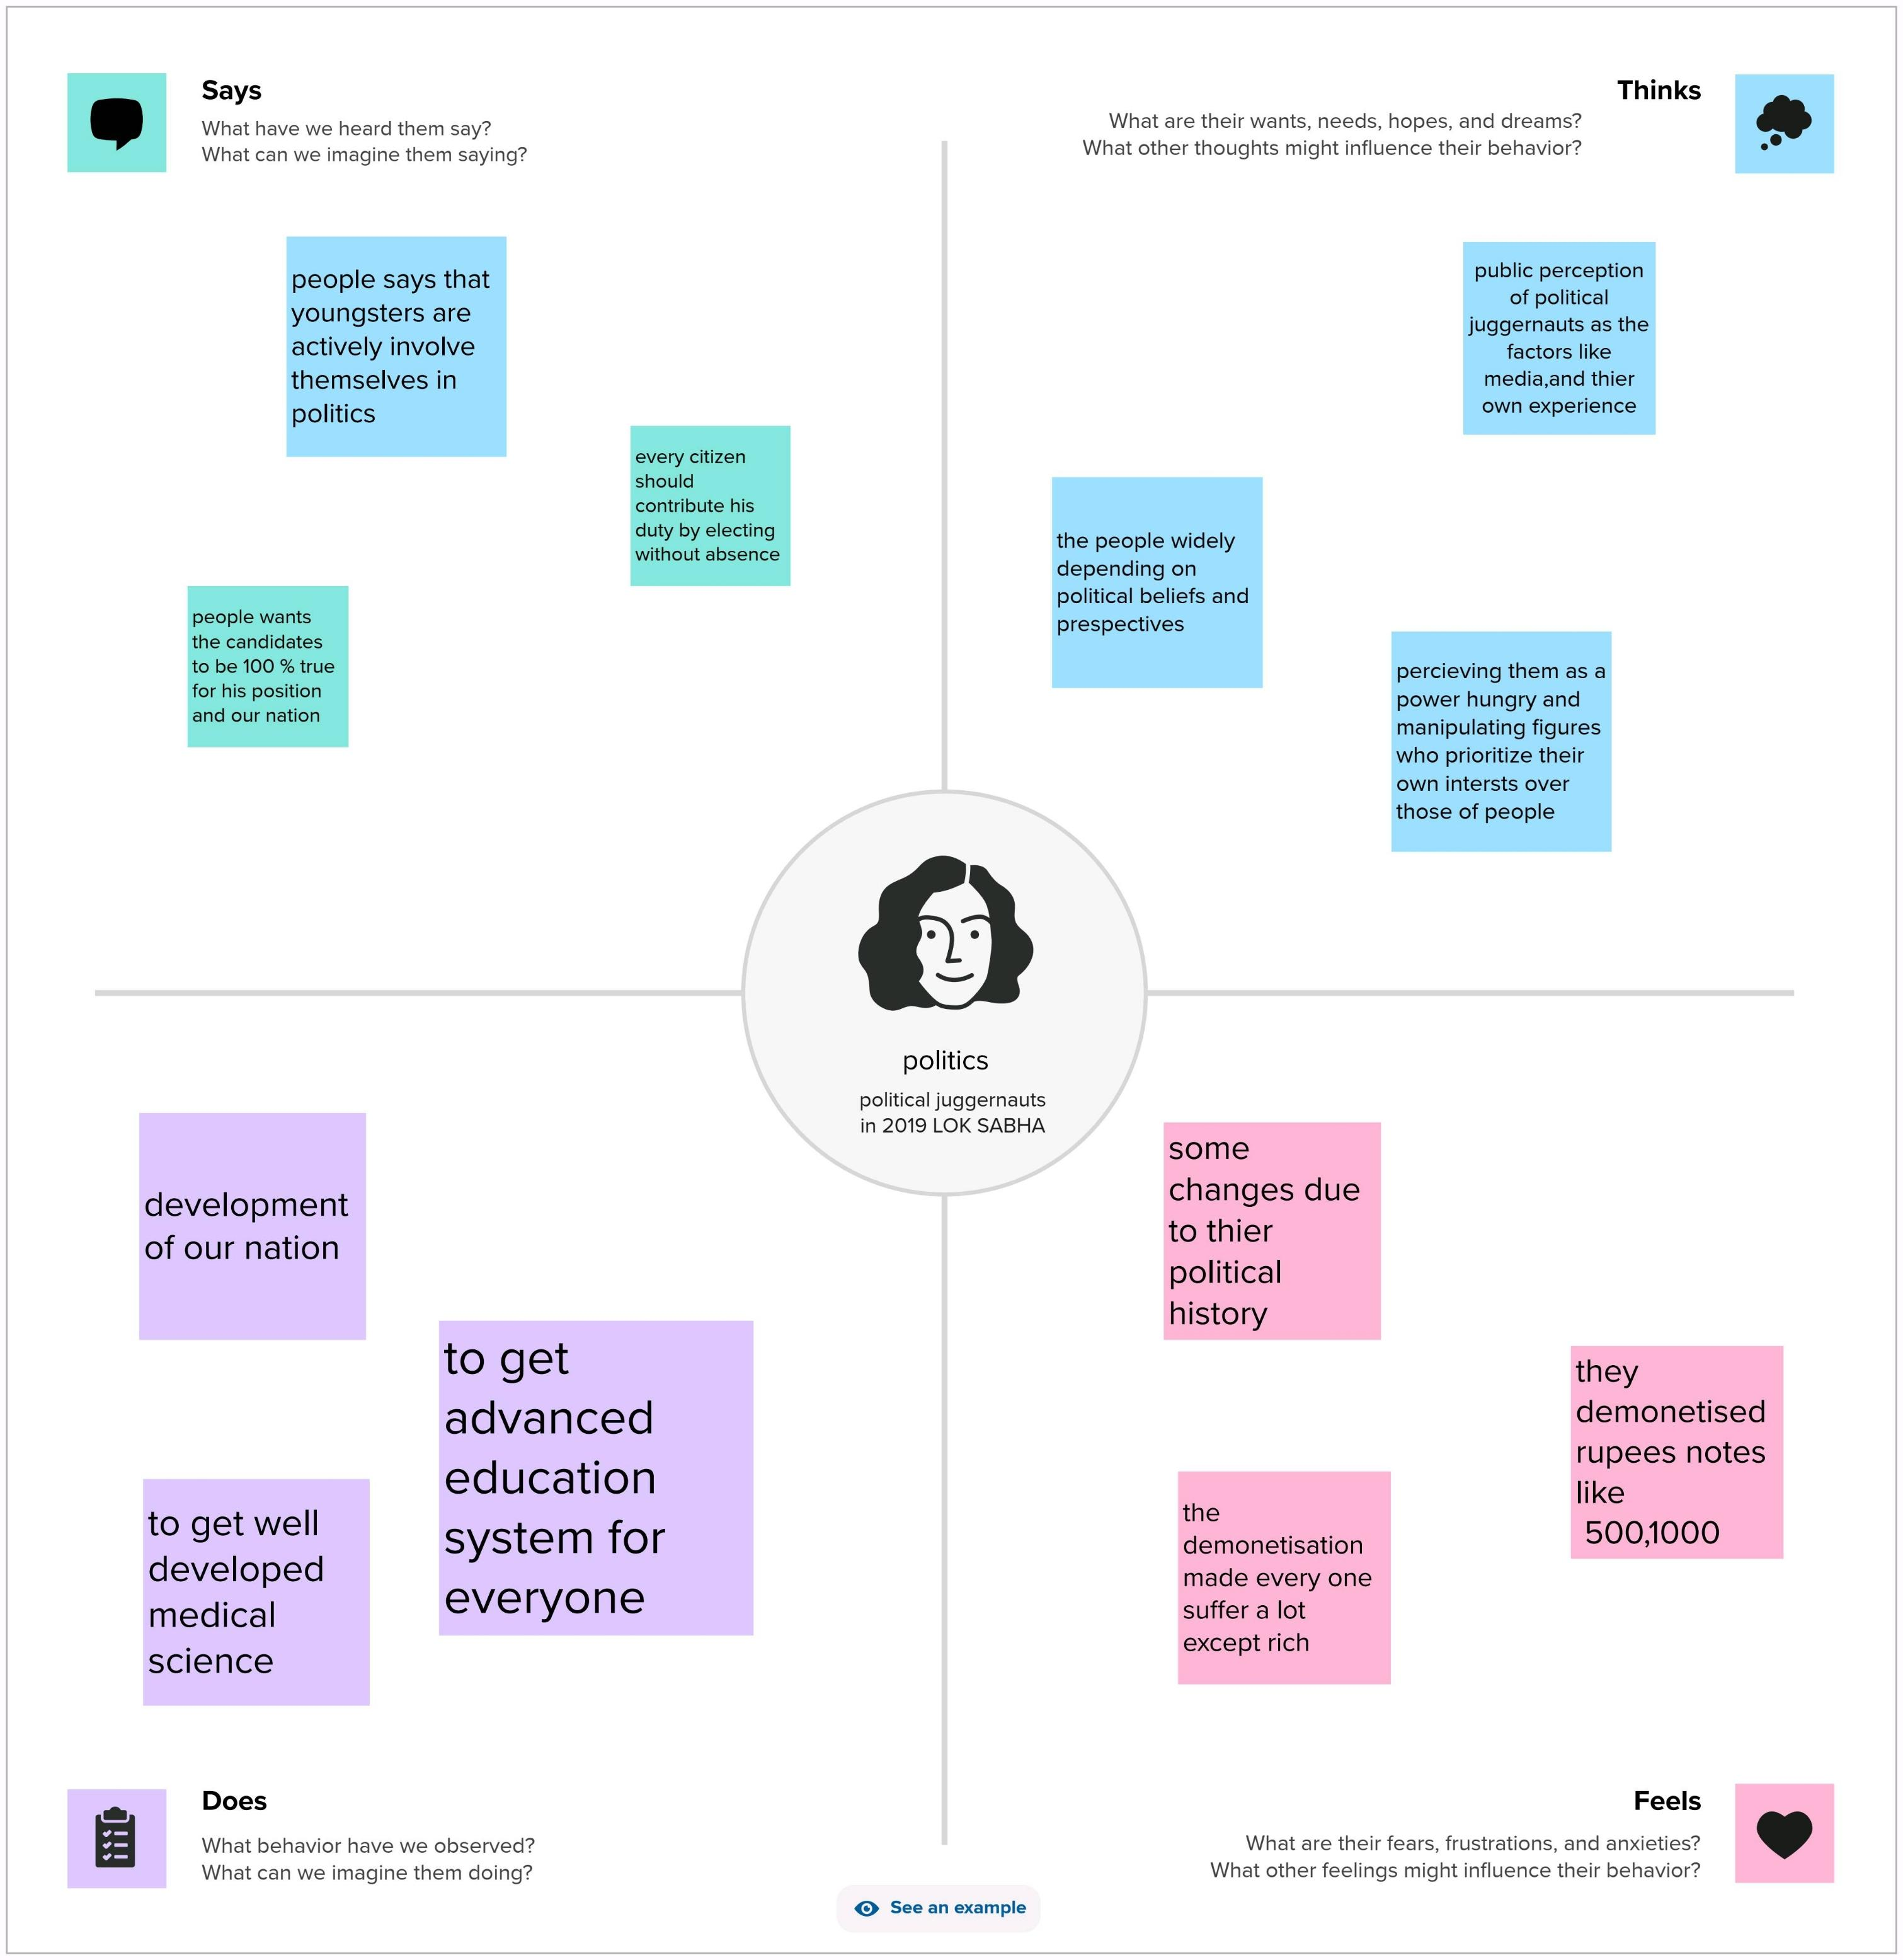
Empathy Map

Slide 6
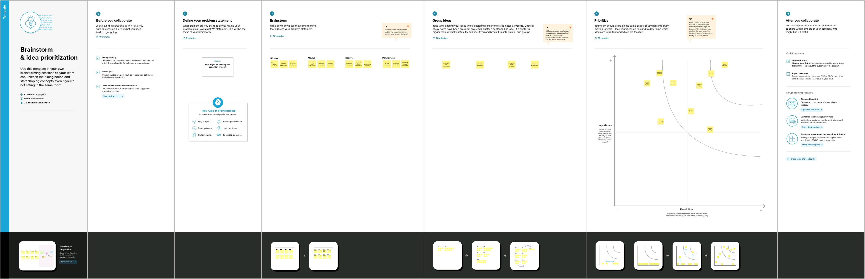
Brainstorm

Slide 7
About Dataset
state: Dimension in lg data represent states names
constituency: it shows dimension of constituency o states
name: participate name from their party
Symbol: part of symbol
part: name of party
gender: gender of participant
criminal cases: cases on party participant
Category: BC SC OBC
winners: winners in data
Age: age of canditte
General votes:shows total general vote
Postal votes: postal vote from country
Total electors: total count of electors in a country

Slide 8
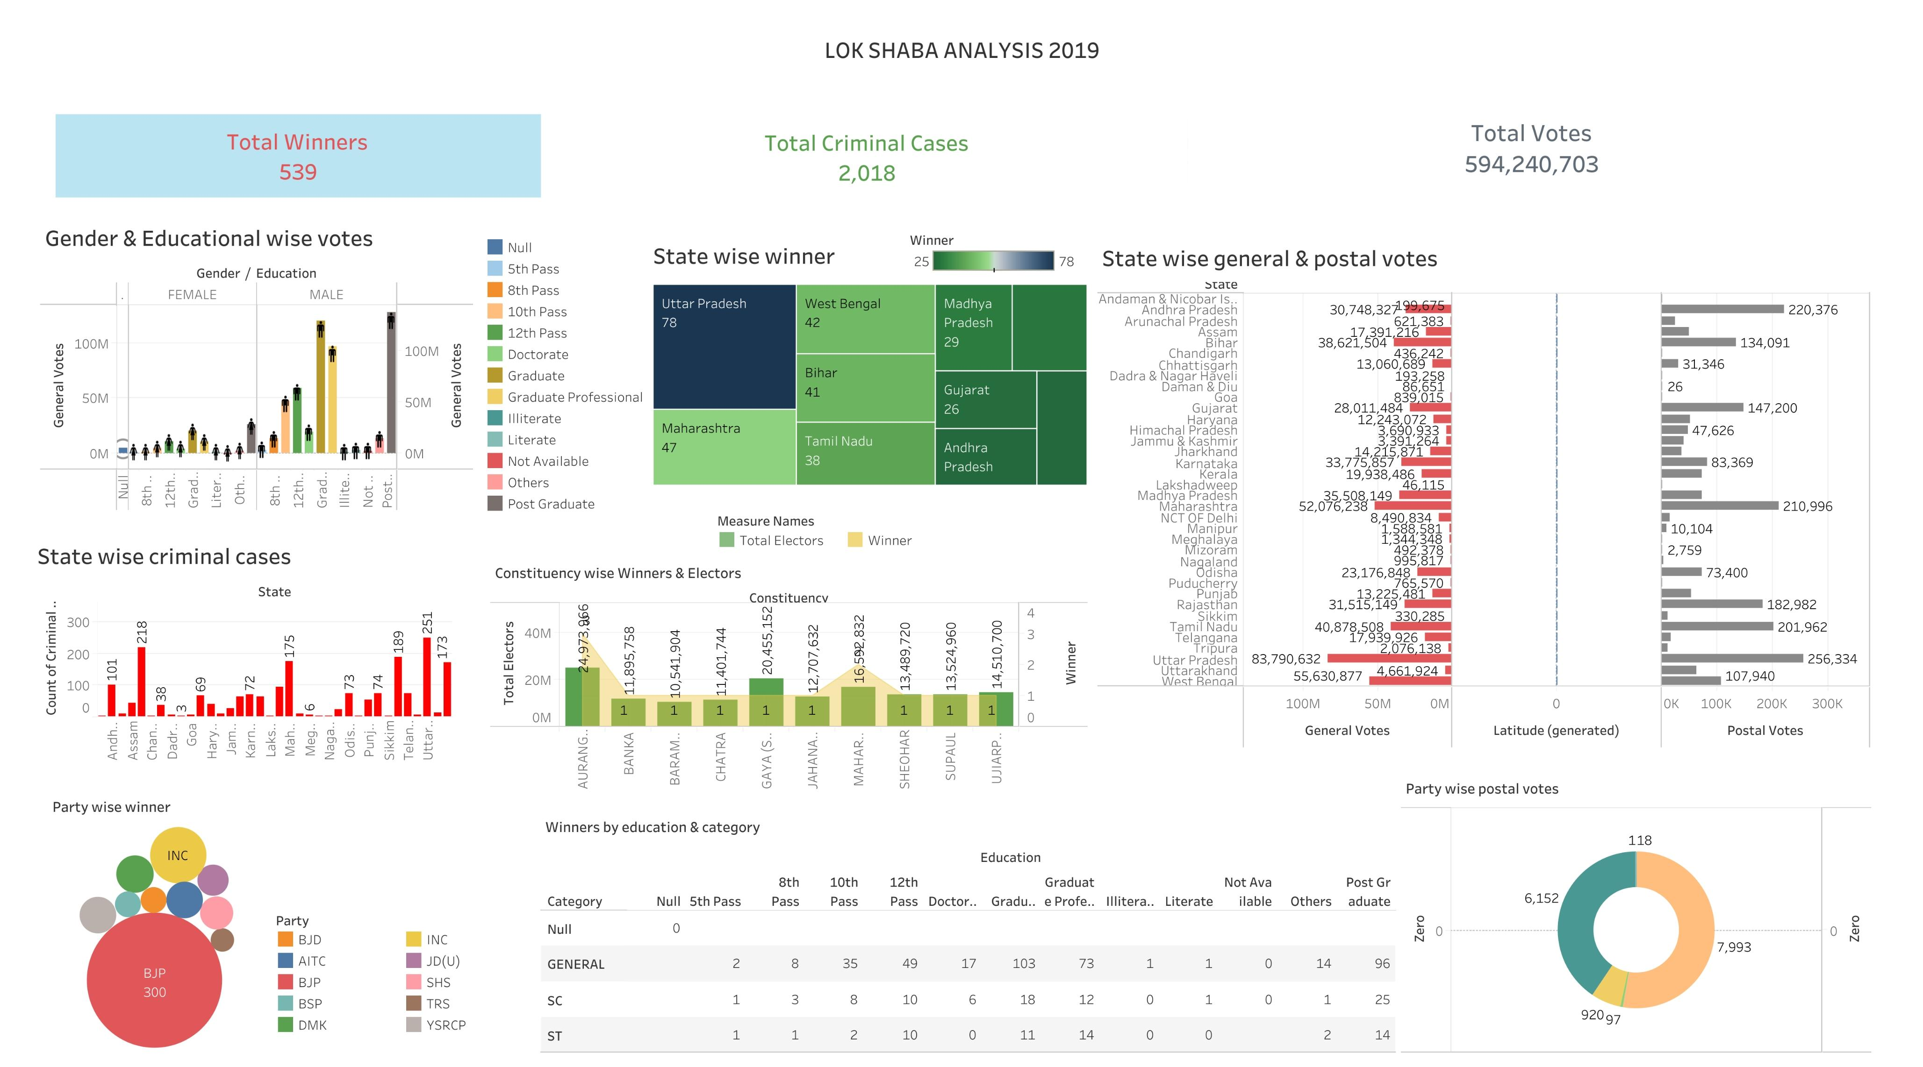
DASBOARD

Slide 9
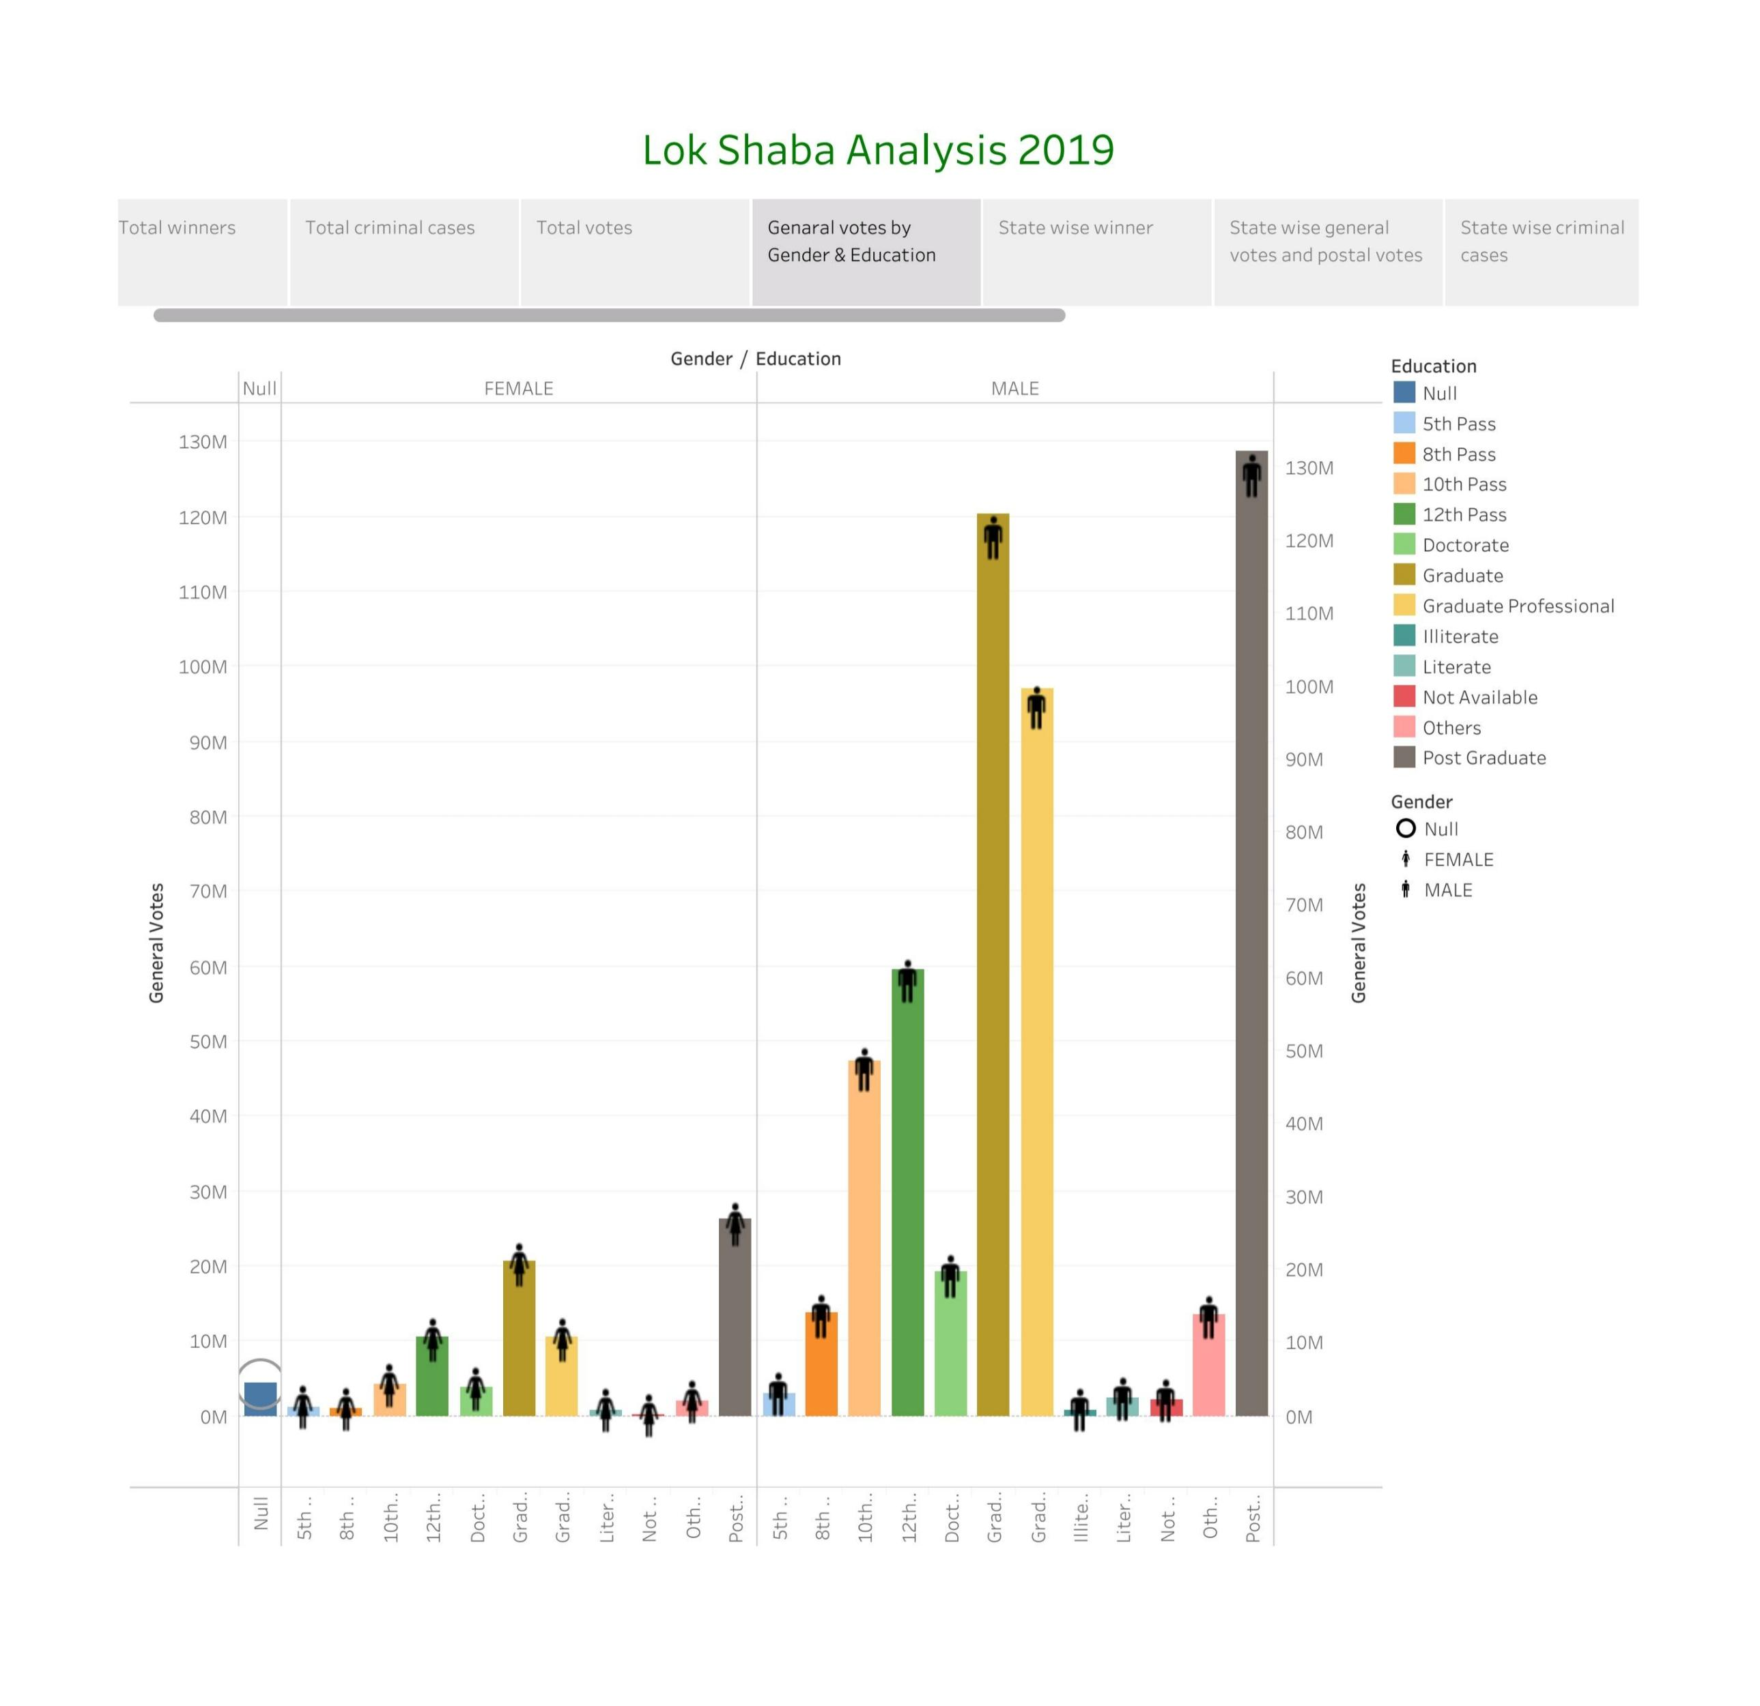
STORY

Slide 10
ADVANTAGES
Election are used to change a government smoothly
Election help to integrate the different societies
Election help to socialize the people

Slide 11
DISADVANTAGES
Elections are too expensive to conduct
Minority groups are usually not favoured during election
Election breeds nepotism divisionism and ethnocentrism

Slide 12
CONCLUSION
A election is formal group decision making. To elect means “to select or make a decision”. “my vote is my future power of one vote”

Slide 13
FUTURE HOPE
An election has change the future. To our younger generation as we say that voting is your right and your duty

